Slide 1
HAIR- A TRACE EVIDENCE

Slide 2
What is hair & Biochemistry of hair
Hair is a protein filament that grows from follicles found in the junction between the deep layers of the dermis & hypodermis.
0r
Hair is a slender thread-like outgrowth from the follicles of the skin of mammals.
Hair is composed of a protein called keratin.
Hair is a characteristic of mammalian skin.
Study of hair is called Trichology.
Biochemistry of hair
Hair is made up of 95% of keratin which is synthesized by keratinocytes.
Hair contains lipid and pigments usually consist of melanin proteins.
Uric acid, cholesterol, vitamins, and other organic materials are also constituents of hairs.
Elements like arsenic, lead, iron, and silicon are also found in the hairs.

Slide 3
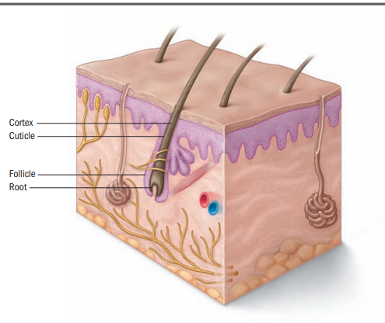

Slide 4
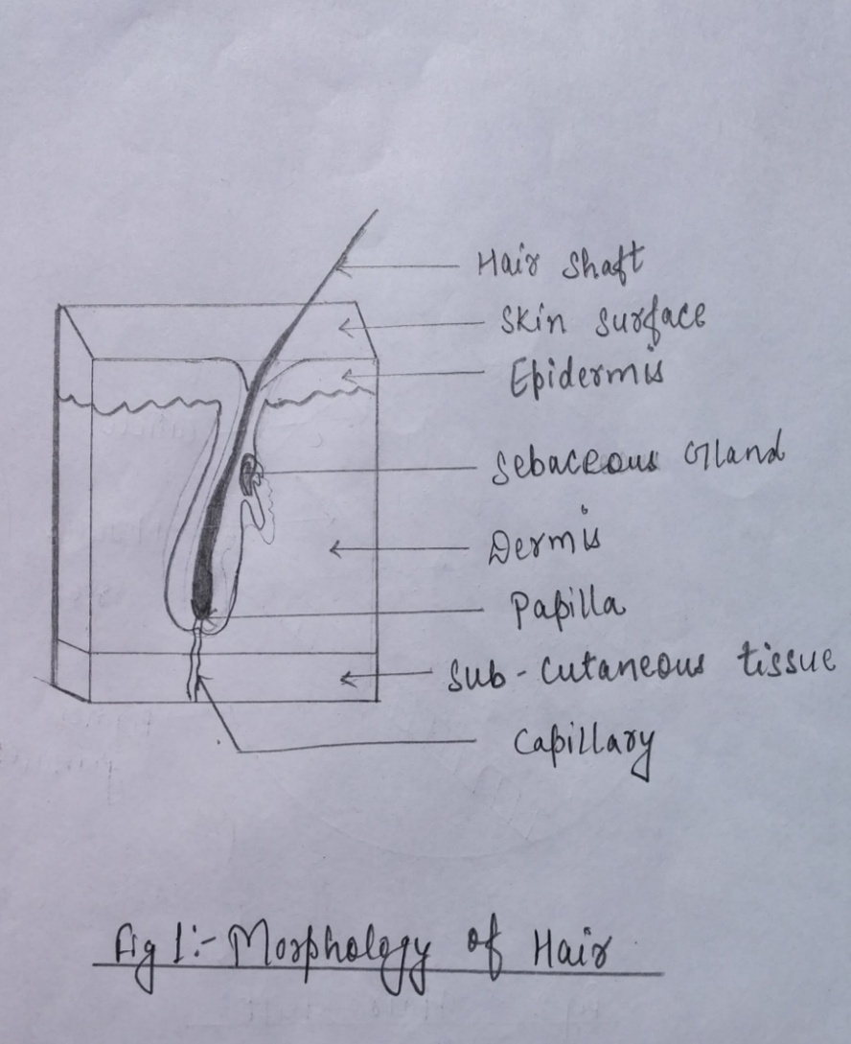

Slide 5
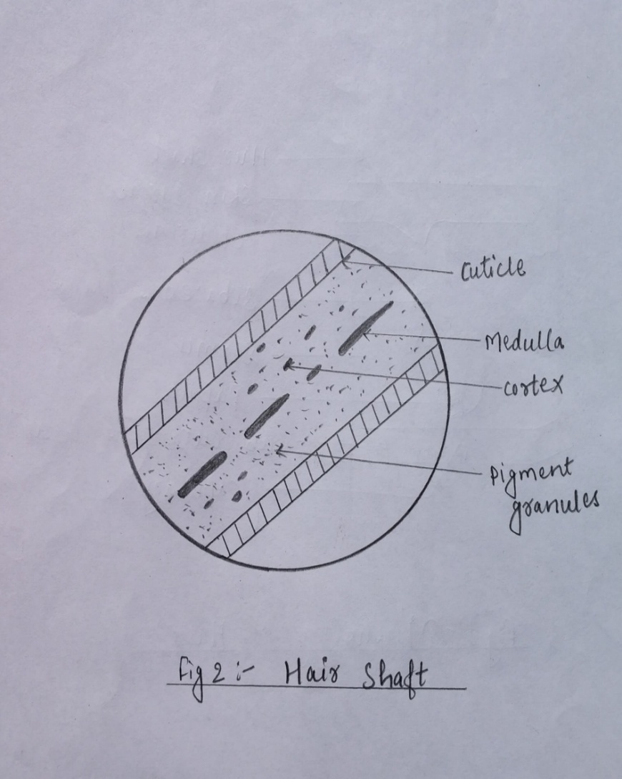

Slide 6
Morphology of hair
The length of a hair extends from its root which is embedded in the follicle, continues into the shaft, and terminates at the tip.
Hair consists of hair shaft and roots.
HAIR SHAFT
It is composed of three layers—
Cuticle
Cortex
Medulla
Cuticle
It is a outer layer of hair shaft.
It made up of a scales that overlap one another.
It protects the inside of the hair shaft.
This can be examined by under the microscope.

Slide 7
3 basic patterns are-
Coronal
The coronal, or crownlike, scale pattern resembles a stack of paper cups.
These scales commonly encountered in the hair of small rodents, bats and rarely in humans.
Spinous
Spinous or petal-like scales are triangular in shape and protrude from the hair shaft.
These scales found in certain animals but never found in humans.
3. Imbricate
Imbricate, or flattened scale, type consists of overlapping scales with narrow margins.
These scales commonly found on hair of humans and rarely in animals.

Slide 8
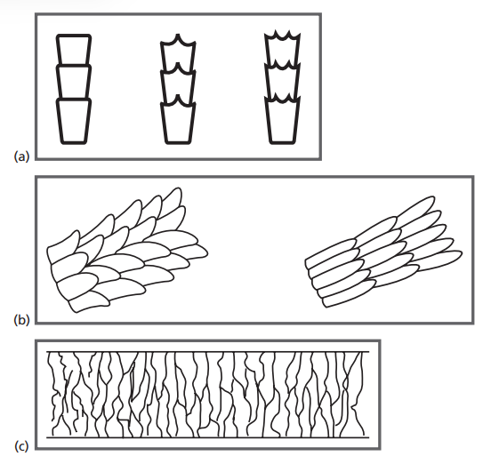
a. Coronal pattern b. Spinous pattern c. Imbricate pattern

Slide 9
Cortex
The main body of the hair shaft.
It contains the pigment granules (melanin) that gives hair its color.
The pigment distribution varies from person to person.
The color, shape, and distribution of these granules provide important points of comparison among the hairs of different individuals. (forensic importance)
Two types of melanin:
Eumelanin - Black & Brown pigments.
Pheomelanin- Red & Yellow pigments.
Natural pigmentation:Natural hair color can be black, brown, blond, red, or white.

Slide 10
Pigment size: when viewed through compound microscope the size of pigments may vary in it can be
large
small
medium
Pigment aggregation: when hair strand sample is viewed through compound microscope the collection of pigments can be noted ie.
Streaked: this pattern of pigment is found in asians
clumped: it in found in africans
Patchy

Slide 11
Medulla
It is the central part of hair.
It can be filled with cells.
The medulla is a collection of cells that looks like a central canal running through a hair.
Types of medulla pattern are-
Continuous - one unbroken line of color.
Interrupted – pigmented line broken at regular intervals
Fragmented – pigmented line unevenly spaced.

Slide 12

Medulla patterns

Slide 13
Medullary Index-
The medullary index measures the diameter of the medulla relative to the diameter of the hair shaft.
It is normally expressed as a fraction.
For humans, the index is generally less than one-third or 0.33.
For animals, the index is greater than one-third or 0.33.

Slide 14
Root
The root and other surrounding cells within the hair follicle provide the tools necessary to produce hair and continue its growth.
Human head hair grows in three developmental stages, and the shape and size of the hair root is determined by the hair’s current growth phase.
The three phases of hair growth are –
Anagen - The initial growth phase during which the hair follicle actively produces hair.
Catagen - A transition stage between the anagen and telogen phases of hair growth.
Telogen - The final growth phase in which hair naturally falls out of the skin.
When pulled from the root, some hairs in the anagen phase have a follicular tag. With the advent of DNA analysis, this follicular tag is important for individualizing hair.
Follicular tag - A translucent piece of tissue surrounding the hair’s shaft near the root that contains the richest source of DNA associated with hair.

Slide 15
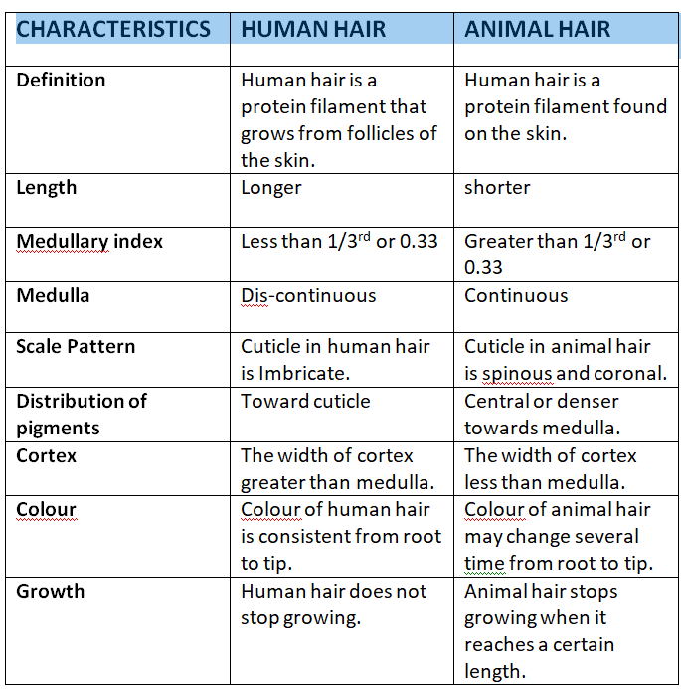
DIFFERENCE BETWEEN HUMAN HAIR AND ANIMAL HAIR

Slide 16
Forensic significance
Hair is encountered as physical evidence in many crime cases.
It helps in crime investigation by establishment of link between suspects, victims and crime scene.
In mass disaster, it can also help in identification of individuals. (link the individual with their parents or relatives) (As hair contain DNA)
It can establish the presence of culprits.
It can also determine the number of culprit if many hair present on the crime scenes.
It helps to identify the weapon of the offence if some hairs gets attached to the weapon.
It links the vehicle used in the commission of crime.
It may also establish the ownership of the articles left at crime scene.
Slow lead or arsenic poisoning is detected through the excess of the poisonous metals in hair.

Slide 17
Hair can easily be left behind at a crime scene. It can also adhere to clothes, carpets, bed sheets, sofa and many other surfaces.
Occupation can also be determined by hair. If a person is working on a coalfield, coal particle can be found on his hair or if a person is working on a cement factory cement particle may found on his hair.
Hair evidence sometimes may contain blood, semen or nasal fluid which can be further analyze to determine individuality.
Geographical area can also be determined for e.g., if in a particular area arsenic content in water is significantly high than through hair examination we can determine that particular belongs to which area.
Highlighted colored hair, bleached hair, hair gel, hair spray or if any other hair cosmetics were used then it will help to narrow down the suspect list.

Slide 18
If hair is forcibly removed from a victim, the entire hair follicle may be present. Hair follicle may present at the roots of hair through which DNA can be determined.
Sex of the individual can ne determined with the help of barr body if root was present in hair.
Racial Origin of Hair can be Determined. children
( Negroid hairs are normally kinky, containing dense, unevenly distributed pigments. Caucasian hairs are usually straight or wavy, with very fine to coarse pigments that are more evenly distributed when compared to Negroid hair.
Mongoloid hairs often have a dense pigment distribution, and also tend to have thicker hair shaft diameters when compared to the other two races. Having continuous medulla.)
It also helps in determining cases of Poaching and theft of animal.

Slide 19
A rough estimate of the age of person from the hair can be made. In growing children the hair is soft and fine. They become coarser with age.
Collection of hair sample.
Hand picking or with the help of tweezer or forcep
Tape Lifting
In large area like Inside the vehicle, vacuuming can done.
Examination: Hair are examined Visually and microscopically.
Visual Examination
-Visual Examination reveals colour, length & general condition of the hair.
It may give an idea whether the hair has been dyed or not.
The presence & absence of the contaminants is also indicated.
2. Microscopy
Scale pattern
Medulla pattern
Pigment distribution
The root & the end.

